Slide 1
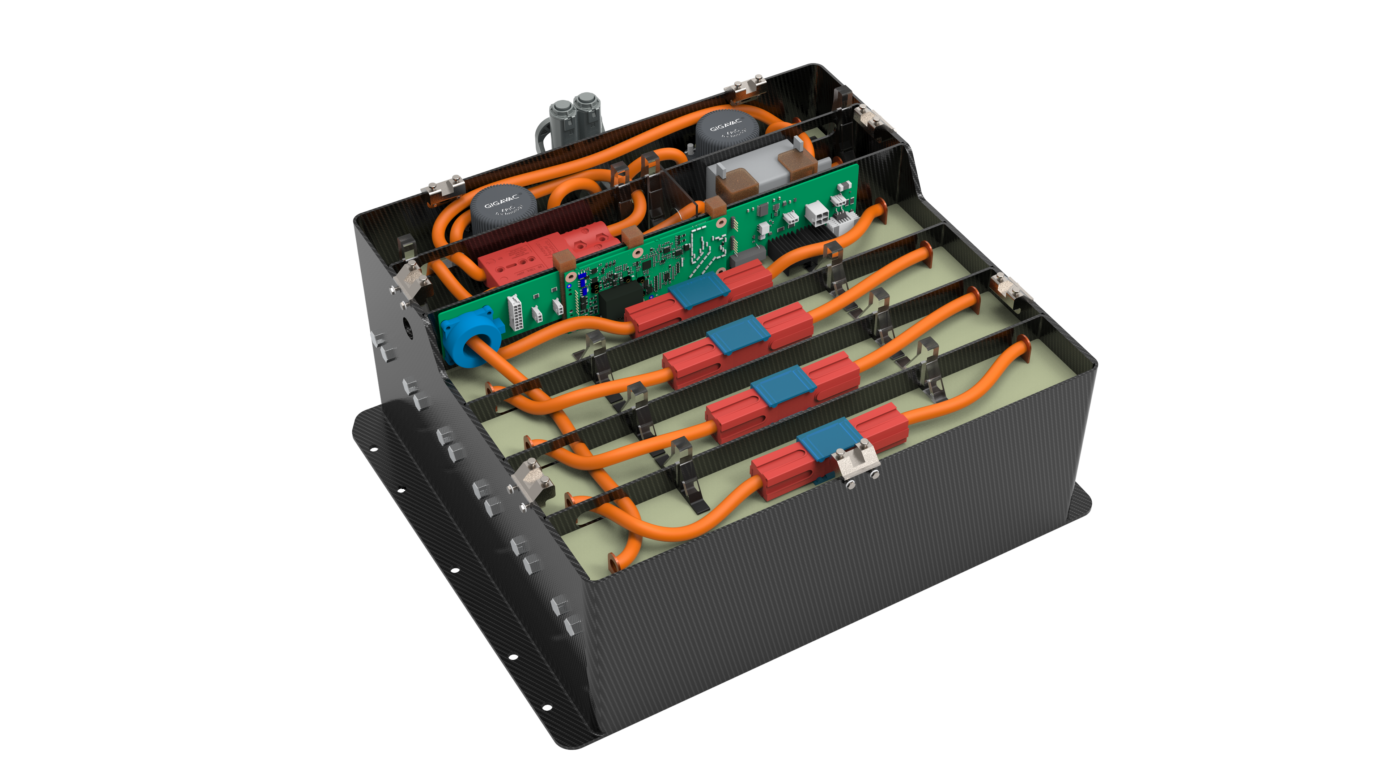
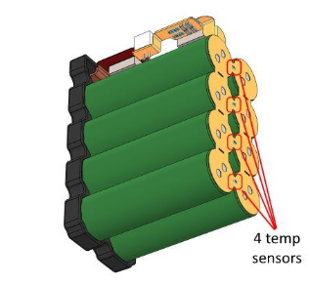
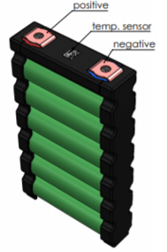
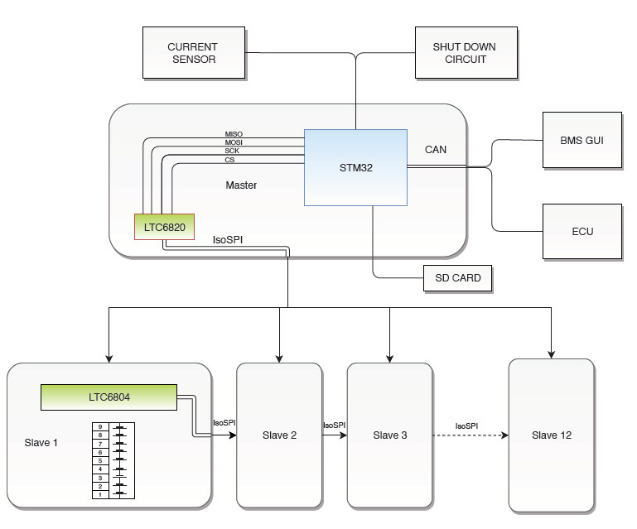
ACCUMULATOR IMPROVEMENT
6 Sony VTC5 cells per module
15 Ah nominal cap
3,6 V nominal capacity
Built in temperature sensors for each cell
MAX V
WEIGHT
KWH
CELLS SERIES
BATTERY MONITORING SYSTEM
Custom BMS suitable for our solution
Modular architechture for easy HW upgrade
Distribuited architecture
Internal isoSPI communication protocol
External CAN bus communication

